Slide 1


Weda.lk:AI/ML Driven Maintenance Service Provider Matching Platform For Sri Lanka
Project ID: RP26-IT-072

Slide 2


01. Introduction
The Core Problem:
In Sri Lanka, users seeking services (AC repair, plumbing, electrical work) rely on inefficient listing-based platforms (e.g., classified websites). These platforms provide long, static lists without intelligent filtering.
The Gravity : for Users
AcademicWasted time contacting multiple providers
High risk of selecting unqualified or unavailable providers
Inefficient and unreliable matching.
The Gravity : For Society & Trust
Increased time and effort for basic service needs.
Poor service quality due to incorrect matching.
Loss of trust in digital service platforms.
Reduced income opportunities for skilled but less visible providers.

Slide 3

Introduction Cont.
Individuals & Households (Primary Users)
Skilled but Less Visible Providers
General Society
Digital Platform Ecosystem
Who will be benefited?

Slide 4

02. Design Excellence of the Overall Solution
Hybrid Recommendation Engine – Matches providers using CF, CBF, and BERT.
Advantage: Moves beyond basic filters to understand semantic meaning and user preferences.
2. Temporal & Contextual Matching – Considers real-time availability, location, weather, and time.
Advantage: Eliminates "unavailable provider" waste; matches based on real-world context.
Skill Verification & Credibility Scoring – Evaluates provider trustworthiness and qualifications.
Advantage: Prevents unqualified providers from being matched, ensuring quality.
Sentiment Analysis & Fake Review Detection – Analyzes feedback using LSTM and detects fake reviews.
Advantage: Ensures trust and reliability; prevents manipulation of ratings.

Slide 5
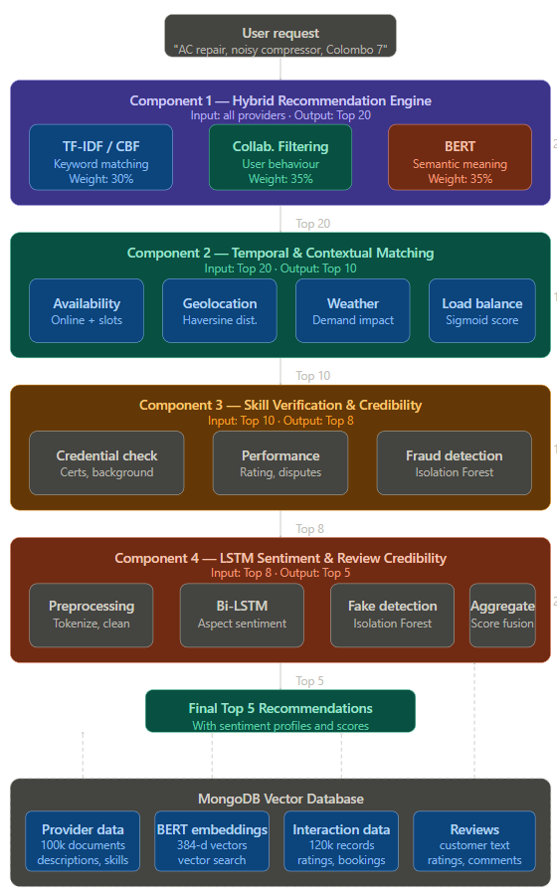
System Architecture Diagram

Slide 6
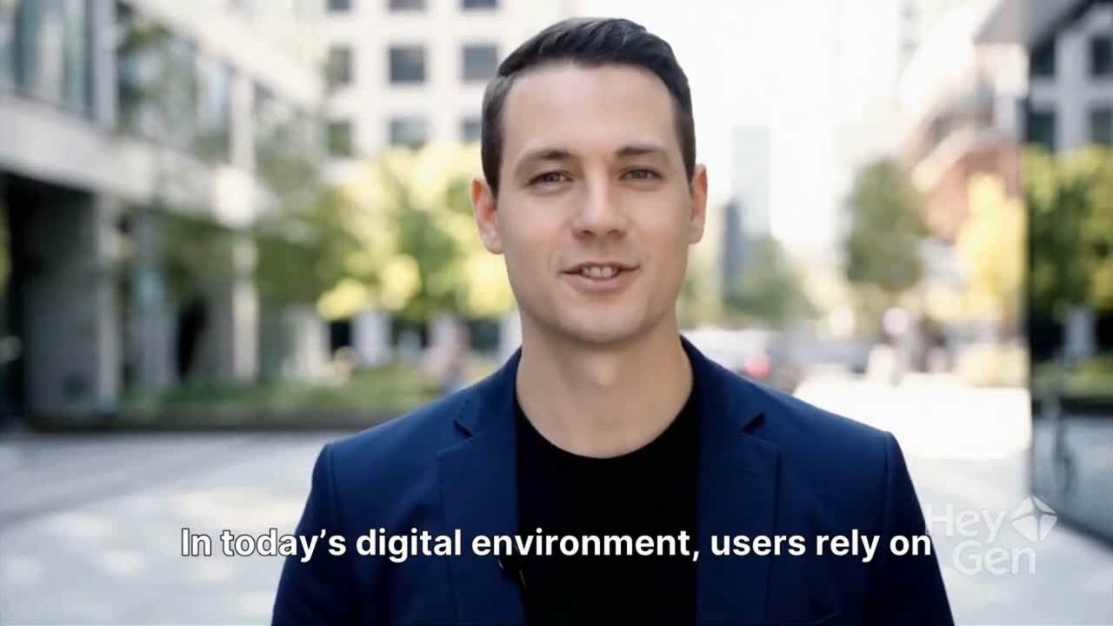
03. System Video
(Letters)

Slide 7

IT22371836 |Hewapathirana n.t.
Hybrid – Multialgorithm Recommendation Engine
BSc (Hons) Degree in Information Technology (specialization in Information Technology)
IT223718236 | Hewapathirana N.T. | RP26-IT-072

Slide 8

Component 01: Hybrid-Multialgorithm Recommendation Engine.
The Solution's Approach to Addressing the Sub-Problem
  Developed a Hybrid Recommendation System - Combined multiple ML/DL techniques to improve recommendation accuracy.
  Used TF-IDF for Keyword-Based Matching - Extracts important keywords from user queries and provider descriptions.
  Measures textual similarity between user needs and provider services.
  Used BERT for Semantic Understanding - Captures contextual meaning of user requests.
  Used Collaborative Filtering (CF) - Analyses user interactions, ratings, and booking history.
  Provider Credibility Scoring – Using interaction frequency, booking success rate
  Hybrid Weighted Scoring Mechanism- Hybrid Score = 0.30 × TF-IDF + 0.35 × BERT + 0.35 × CF
  Ranking & Filtering - Ranked providers based on hybrid scores.
  Generated Top-20 Recommendations.
IT223718236 | Hewapathirana N.T. | RP26-IT-072

Slide 9
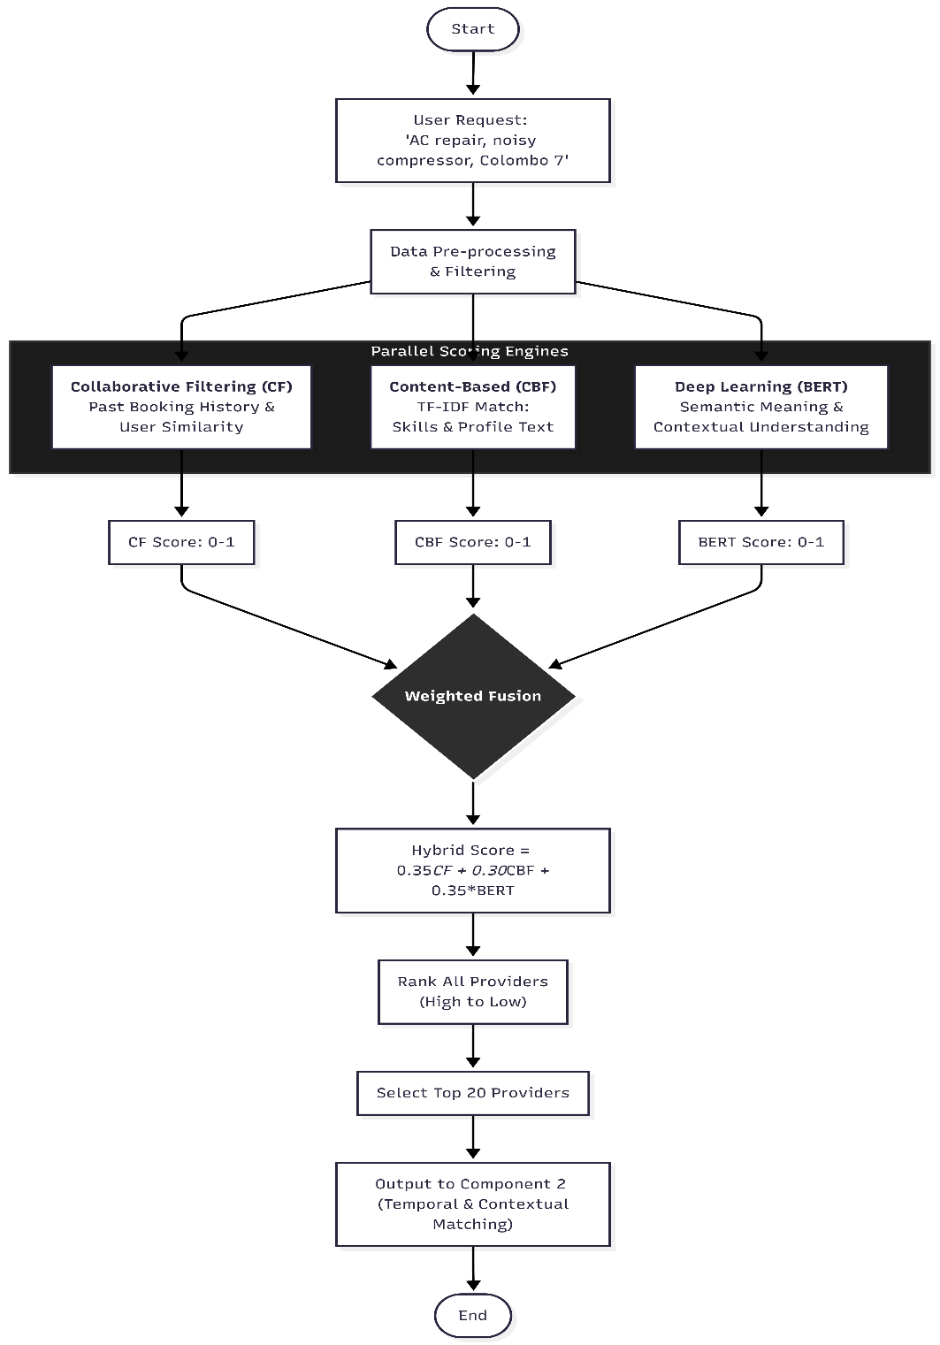
Flow chart – component 1
IT223718236 | Hewapathirana N.T. | RP26-IT-072

Slide 10
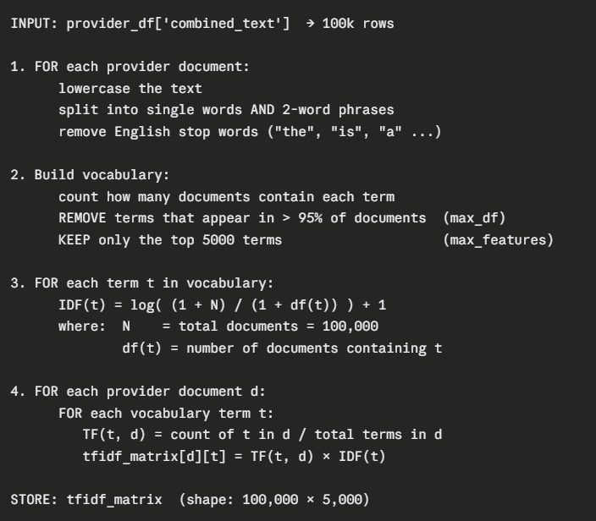
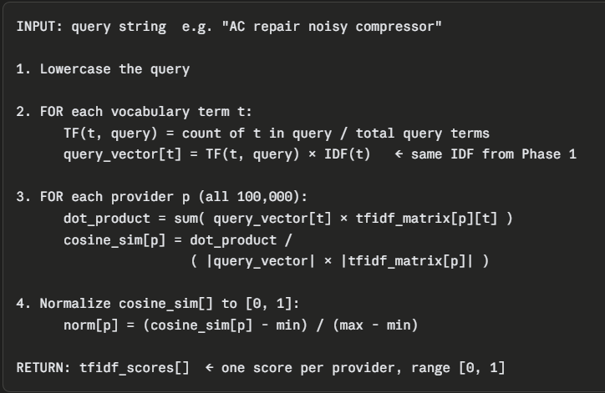
Achievement Evidence
Phase 2 — Score (runs at every user search)
Pseudo code for TF-IDF phase 1-Fit (runs once on provider_dataset)
IT223718236 | Hewapathirana N.T. | RP26-IT-072

Slide 11
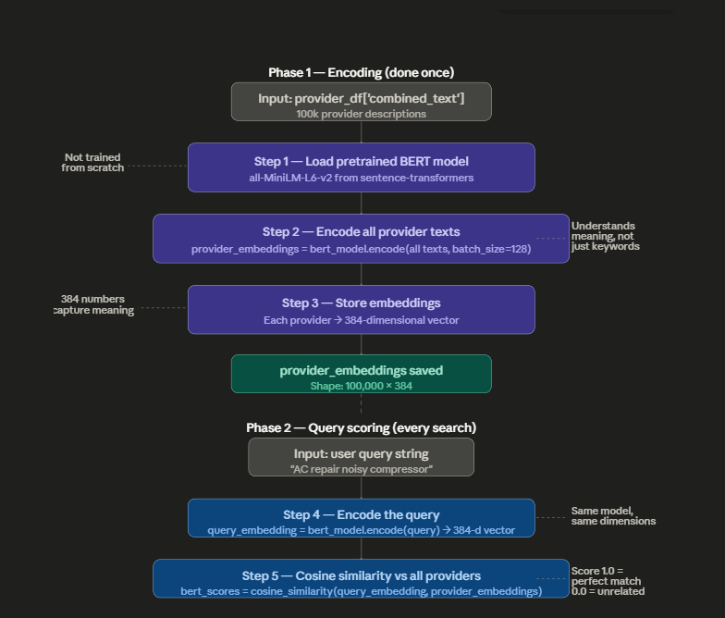
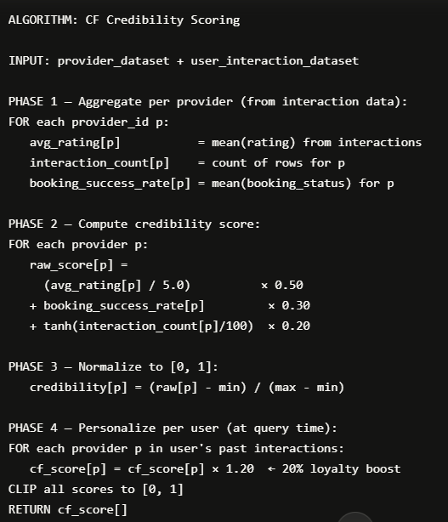
Flow chart for BERT
Pseudo code for CF
IT223718236 | Hewapathirana N.T. | RP26-IT-072

Slide 12
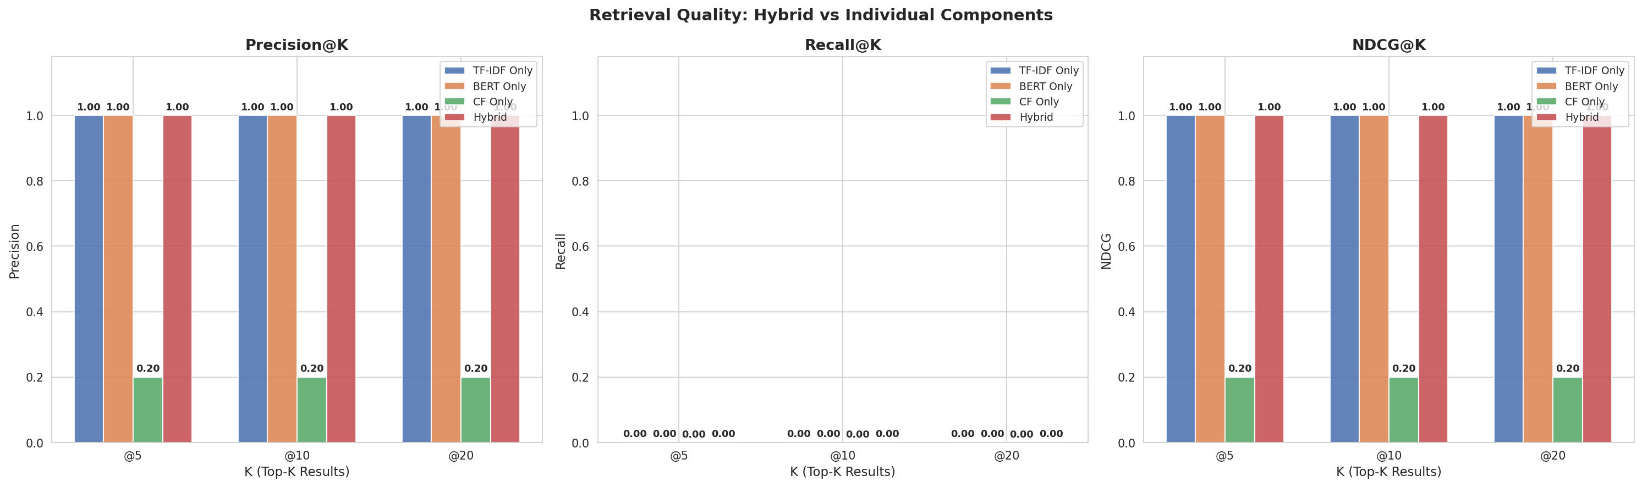
Evaluation Precision@K, Recall@K and NDCG@K for all methods

Slide 13
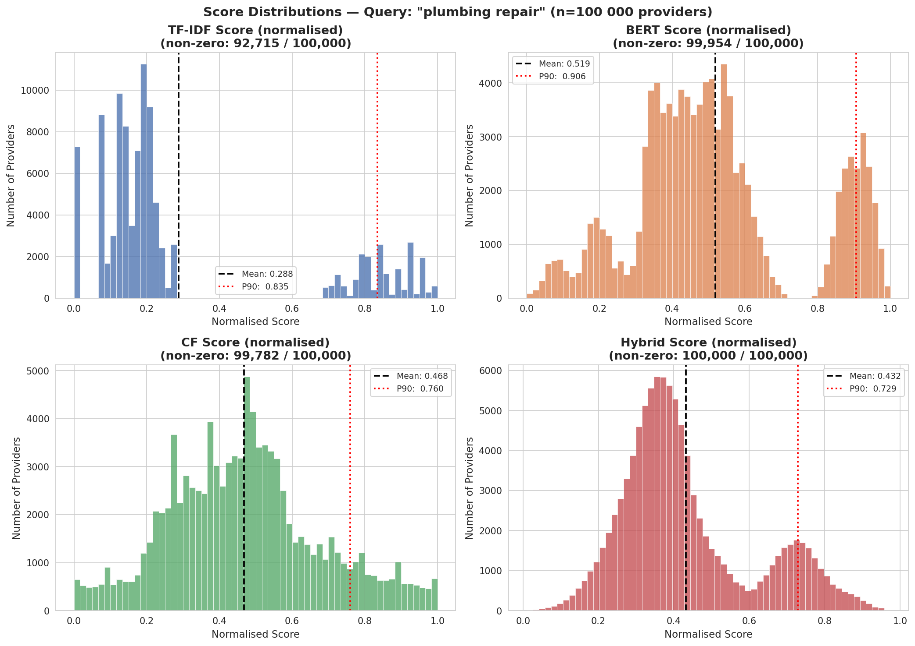
IT223718236 | Hewapathirana N.T. | RP26-IT-072

Slide 14
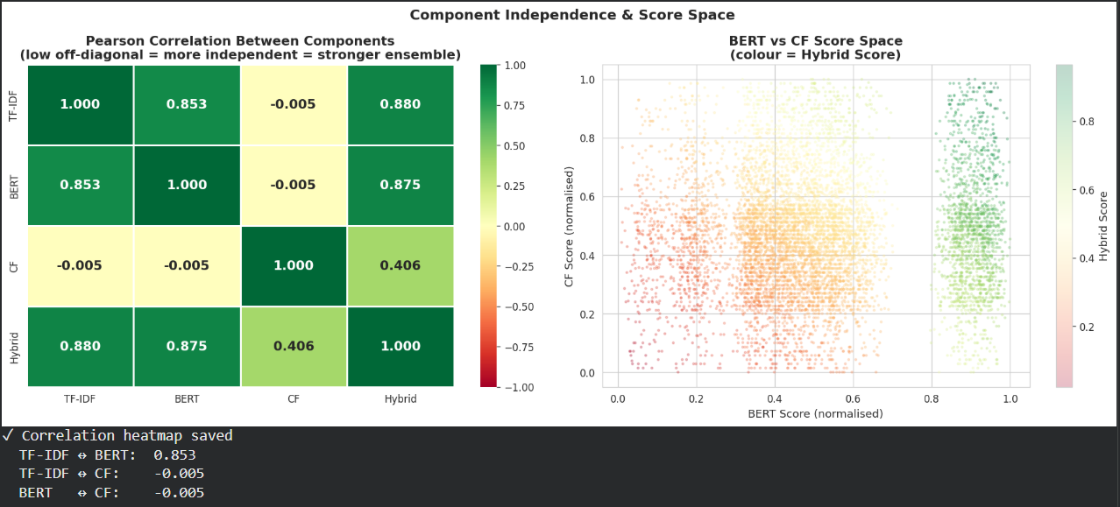
IT223718236 | Hewapathirana N.T. | RP26-IT-072

Slide 15
Current Implementation Status
Backend: Ranking algorithms (BERT, CF, TF-IDF) implemented.
Data: Pre-processing and Vectorization of 100k+ & 120k+ records completed.
Frontend: Basic Auth (Login/Signup) finished.

Slide 16
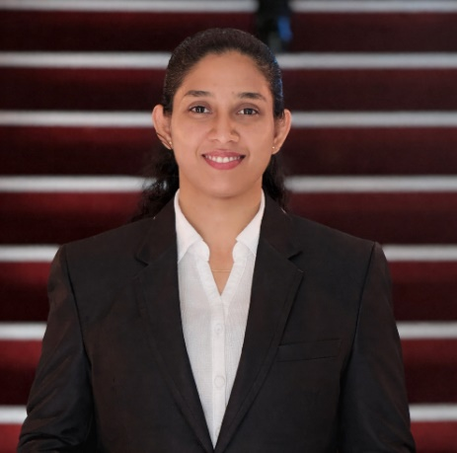
IT22190048 | Masakorala A.H.
Temporal and Contextual Matching System for Service Provider Recommendations(Availability, Location, Weather, and Time Factors).
BSc (Hons) Degree in Information Technology (specialization in Information Technology)
IT22190048 | Masakorala A.H. | RP26-IT-072

Slide 17

Component 02: Temporal and Contextual Matching System for Service Provider Recommendations(Availability, Location, Weather, and Time Factors).
The Solution's Approach to Addressing the Sub-Problem
Live map lets users click to select location
Weather forecast shown for outdoor jobs (temperature, rain, wind)
Providers sorted by distance, availability, and working hours
Urgency levels (low/normal/high) affect matching priority
The Solution's Approach to Addressing the Sub-Problem
Users pick service type, issue, date, time, urgency, and indoor/outdoor from simple dropdowns and checkboxes.
Users set location by typing or clicking on the map.
After submitting, the system shows matched providers with name, distance, address, hours, and working days.
For outdoor jobs, a weather card shows temperature, rain chance, and wind speed.
IT22190048 | Masakorala A.H. | RP26-IT-072

Slide 18
Component 02: Temporal and Contextual Matching System for Service Provider Recommendations(Availability, Location, Weather, and Time Factors).
Design Excellence/Contribution
UI Design Highlights
Large Map (500px) - Easy location selection
Show/Hide Map Toggle - Saves screen space after location selection
Emerald Green Theme - Professional, trustworthy appearance
Weather Card (gradient) - Outdoor users see forecast before booking
"Nearest" Badge - Helps users choose closest provider
IT22190048 | Masakorala A.H. | RP26-IT-072

Slide 19
IT22117182 | ROOPASINGHE EMNS
Dynamic Skill Verification & Provider Credibility Scoring Model
BSc (Hons) Degree in Information Technology (specialization in Information Technology)
IT22117182 | ROOPASINGHE EMNS | RP26-IT-072

Slide 20
Component 03:Dynamic Skill Verification & Provider Credibility Scoring Model
The Solution's Approach to Addressing the Sub-Problem
Developed a Machine Learning-based Provider Credibility Scoring System.
Evaluated provider trustworthiness using multiple verification factors.
Verified provider identity, certifications, and business registration.
Analysed provider experience and professional references.
Evaluated portfolio quality and historical service reliability.
Implemented Random Forest Regressor and XGBoost Regressor models.
Applied Grid Search Cross Validation for hyperparameter optimization.
Generated credibility scores ranging from 0–100.
Classified providers into Beginner, Intermediate, and Professional levels.
Enhanced recommendation trustworthiness by filtering unqualified providers.
IT22117182 | ROOPASINGHE EMNS | RP26-IT-072

Slide 21
Component 03:Achievement Evidence & Current Status
Achievement Evidence & Model Evaluation
XGBoost achieved higher prediction accuracy.
SHAP analysis used for explainable AI predictions.
Real-time provider credibility prediction completed.
Providers ranked based on trustworthiness and qualifications.
Credibility Scoring Formula
Credibility Score=(0.4×Credential Score)+(0.3×Performance Score)+(0.3×Trust Score)
Key Achievements
The Solution's Approach to Addressing the Sub-Problem
Backend ML models implemented.
Dataset preprocessing and feature engineering completed.
Hyperparameter tuning completed using Grid Search CV.
Credibility prediction API functional.
IT22117182 | ROOPASINGHE EMNS | RP26-IT-072

Slide 22

IT22914200|Tharushika w.a.m.
Bi-LSTM Based Sentiment Analysis & Review Credibilty Module
BSc (Hons) Degree in Information Technology (specialization in Information Technology)
IT22914200 | Tharushika W.A.M. | RP26-IT-072

Slide 23
Component 04: Bi-LSTM Based Sentiment Analysis & Review Credibility Module
The Solution's Approach to Addressing the Sub-Problem
  Developed a Bi-LSTM Based Sentiment Analysis & Review Credibility Module to improve recommendation trustworthiness.
  Applied NLP preprocessing techniques for review cleaning and normalization.
  Performed aspect-level sentiment analysis for quality, punctuality, communication, and professionalism.
  Implemented fake review detection using the Isolation Forest algorithm.
  Filtered suspicious reviews before sentiment score generation.
  Generated weighted sentiment scores from multiple review aspects.
  Enhanced provider ranking using verified sentiment insights.
  Generated explainable recommendations with provider strengths and weaknesses.
  Produced the final Top-5 trustworthy providers for the recommendation system.
IT22914200 | Tharushika W.A.M. | RP26-IT-072

Slide 25
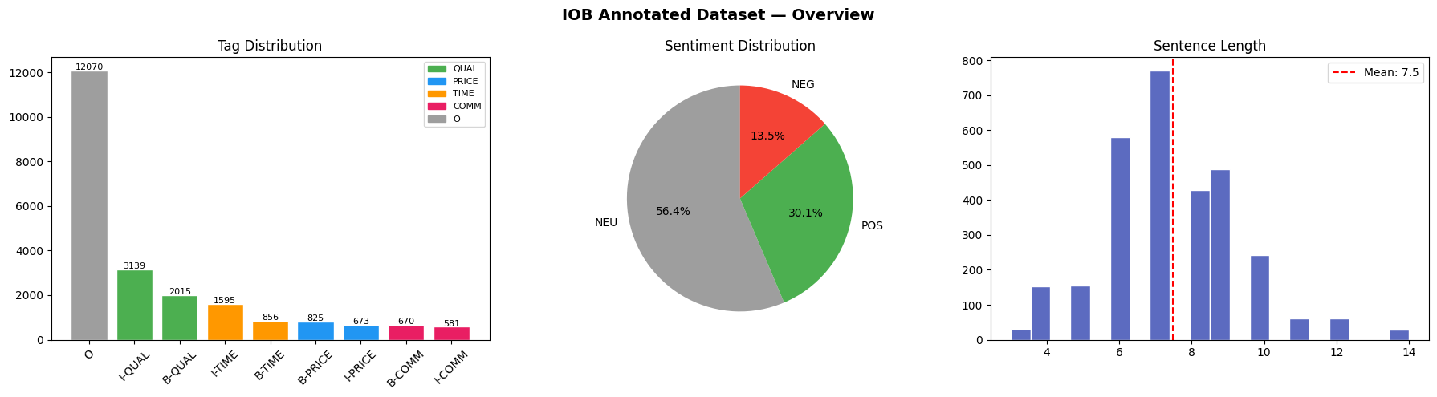
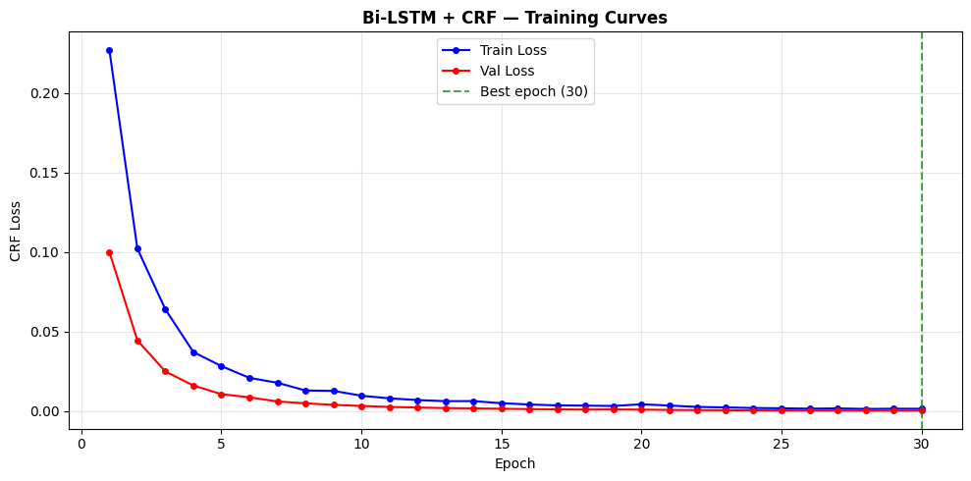
Achievement Evidence
IOB Annotated Reviews
IT22914200 | Tharushika W.A.M. | RP26-IT-072

Slide 26
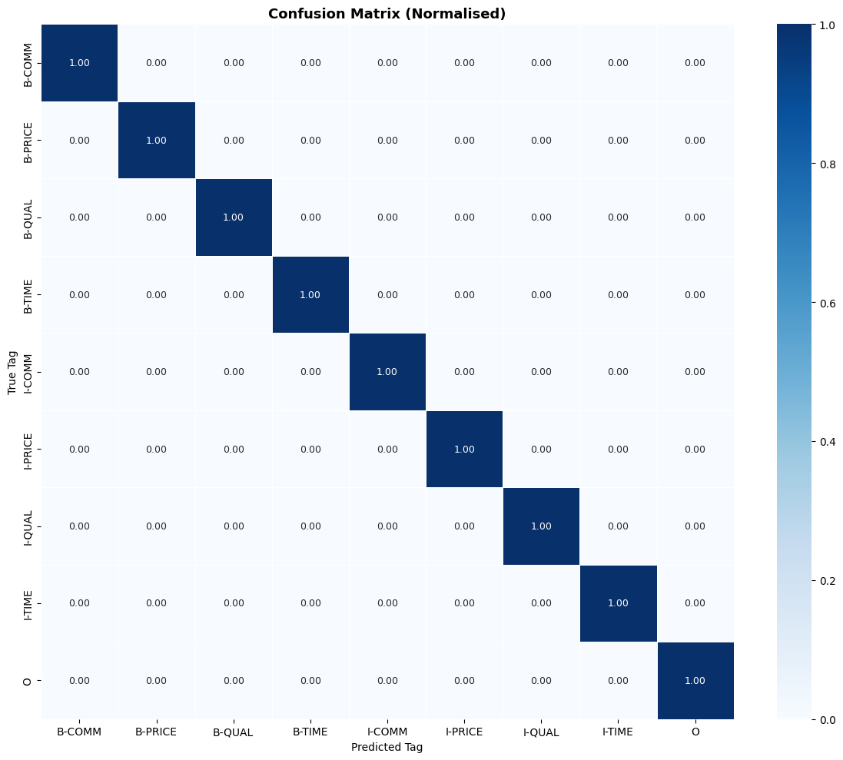
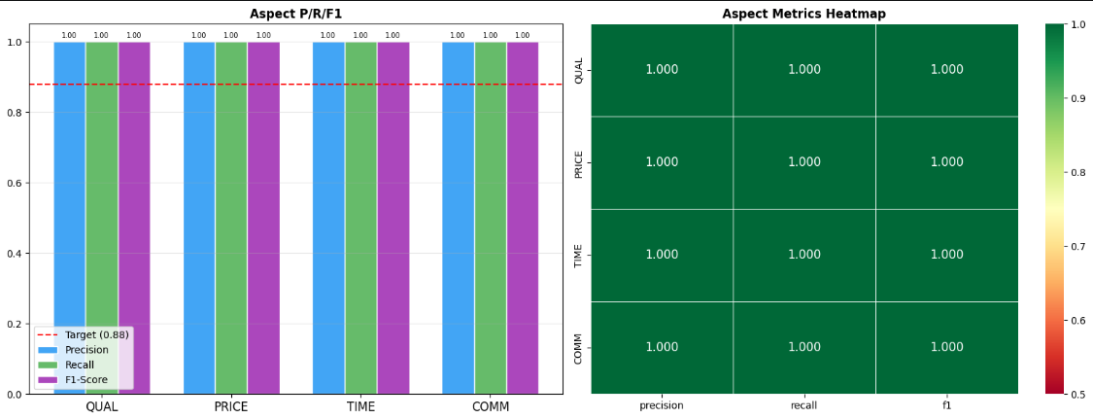
LSTM-Based Sentiment & Review Credibility Module
IT22914200 | Tharushika W.A.M. | RP26-IT-072

Slide 27
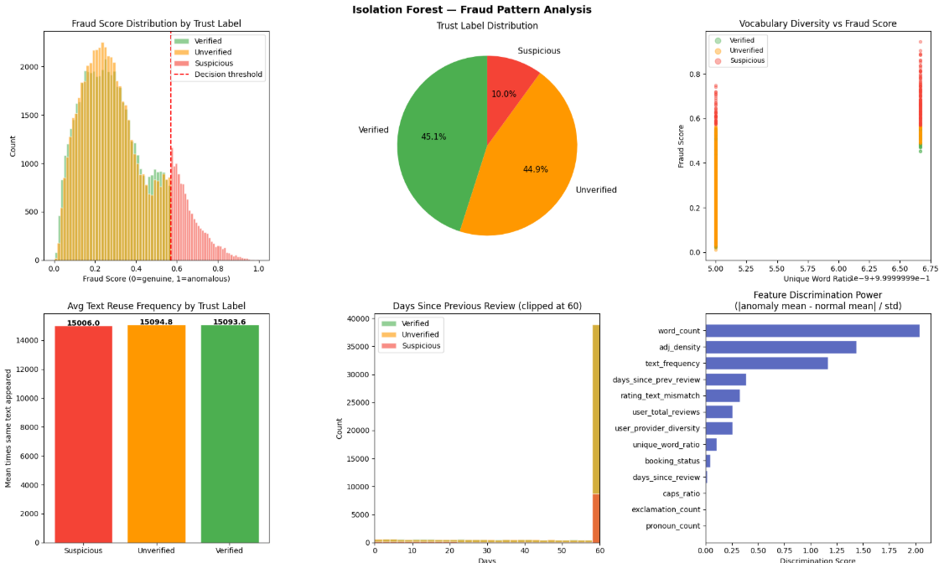
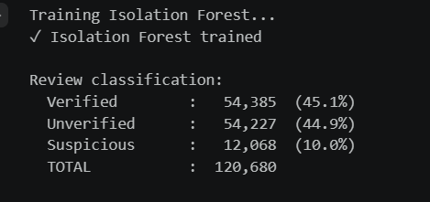
Fraud Detection & Credibility Blending
IT22914200 | Tharushika W.A.M. | RP26-IT-072

Slide 28
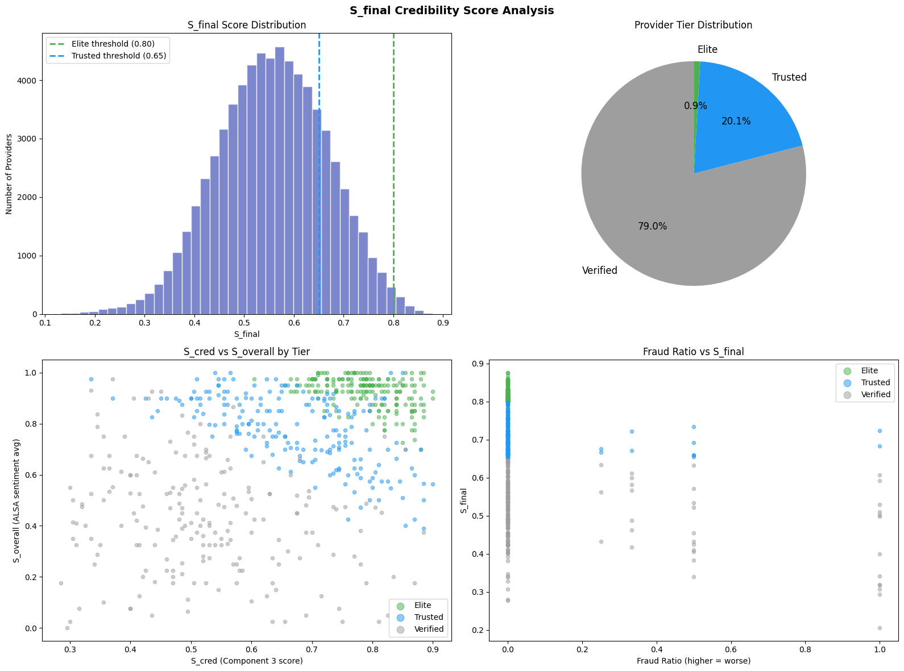
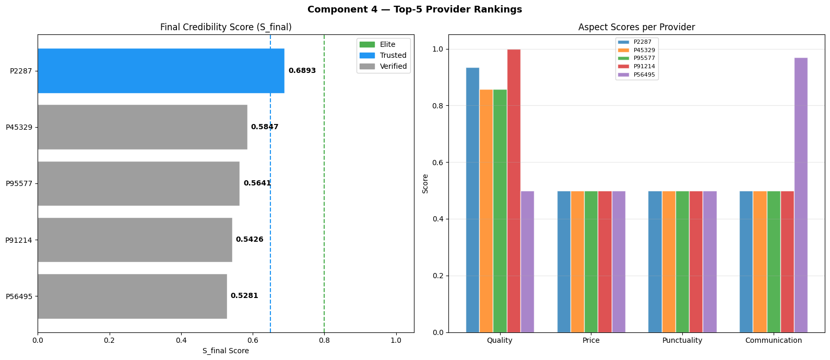
S_final Credibility Blending Formula
IT22914200 | Tharushika W.A.M. | RP26-IT-072

Slide 29
Current Implementation Status
Backend: Bi-LSTM sentiment analysis, aspect extraction, and fake review detection modules implemented.
Data: NLP preprocessing, review cleaning, and Sinhala-English mixed review preparation completed for 110k+ review records.
Model Development: Bi-LSTM with Attention Mechanism and Isolation Forest models trained for sentiment classification and fake review detection.
Sentiment Processing: Aspect-level sentiment scoring for quality, punctuality, communication, and professionalism completed.
IT22914200 | Tharushika W.A.M. | RP26-IT-072

Slide 30

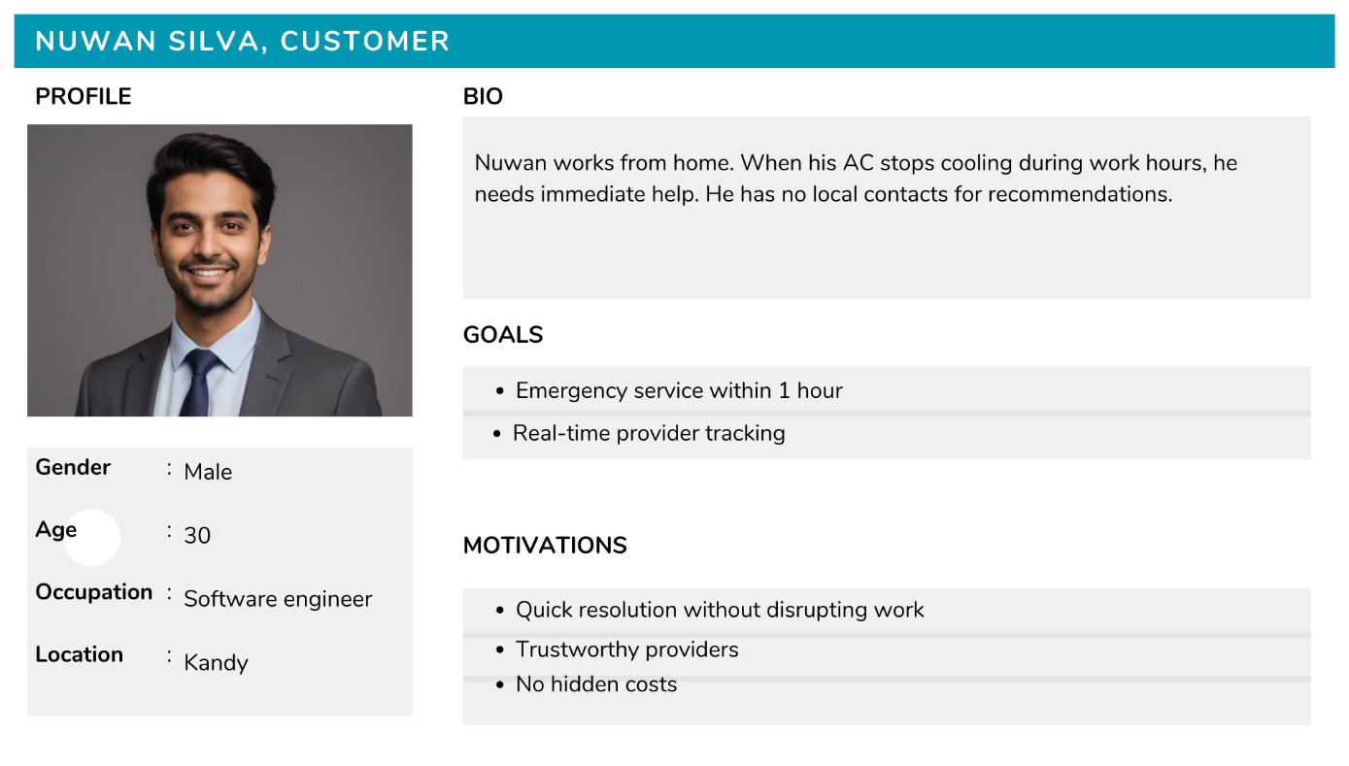
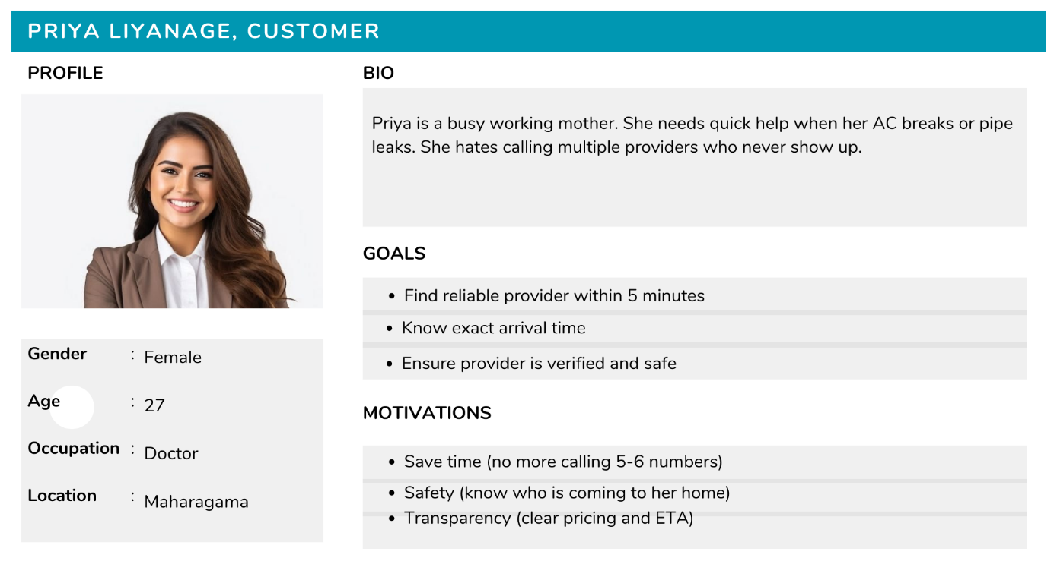
Customer Persona

Slide 31
Thank You!

